Slide 1
O K-edge phonon in Eu-LSCO-p125
Beamline: I21
Proposal: MM29011-1
Time: 2021.10.08-11 (9 shifts)

Slide 2
Software info.
DawnDiamond-2.23.0.v20211005-0856-win32.x86_64-inst

Slide 3
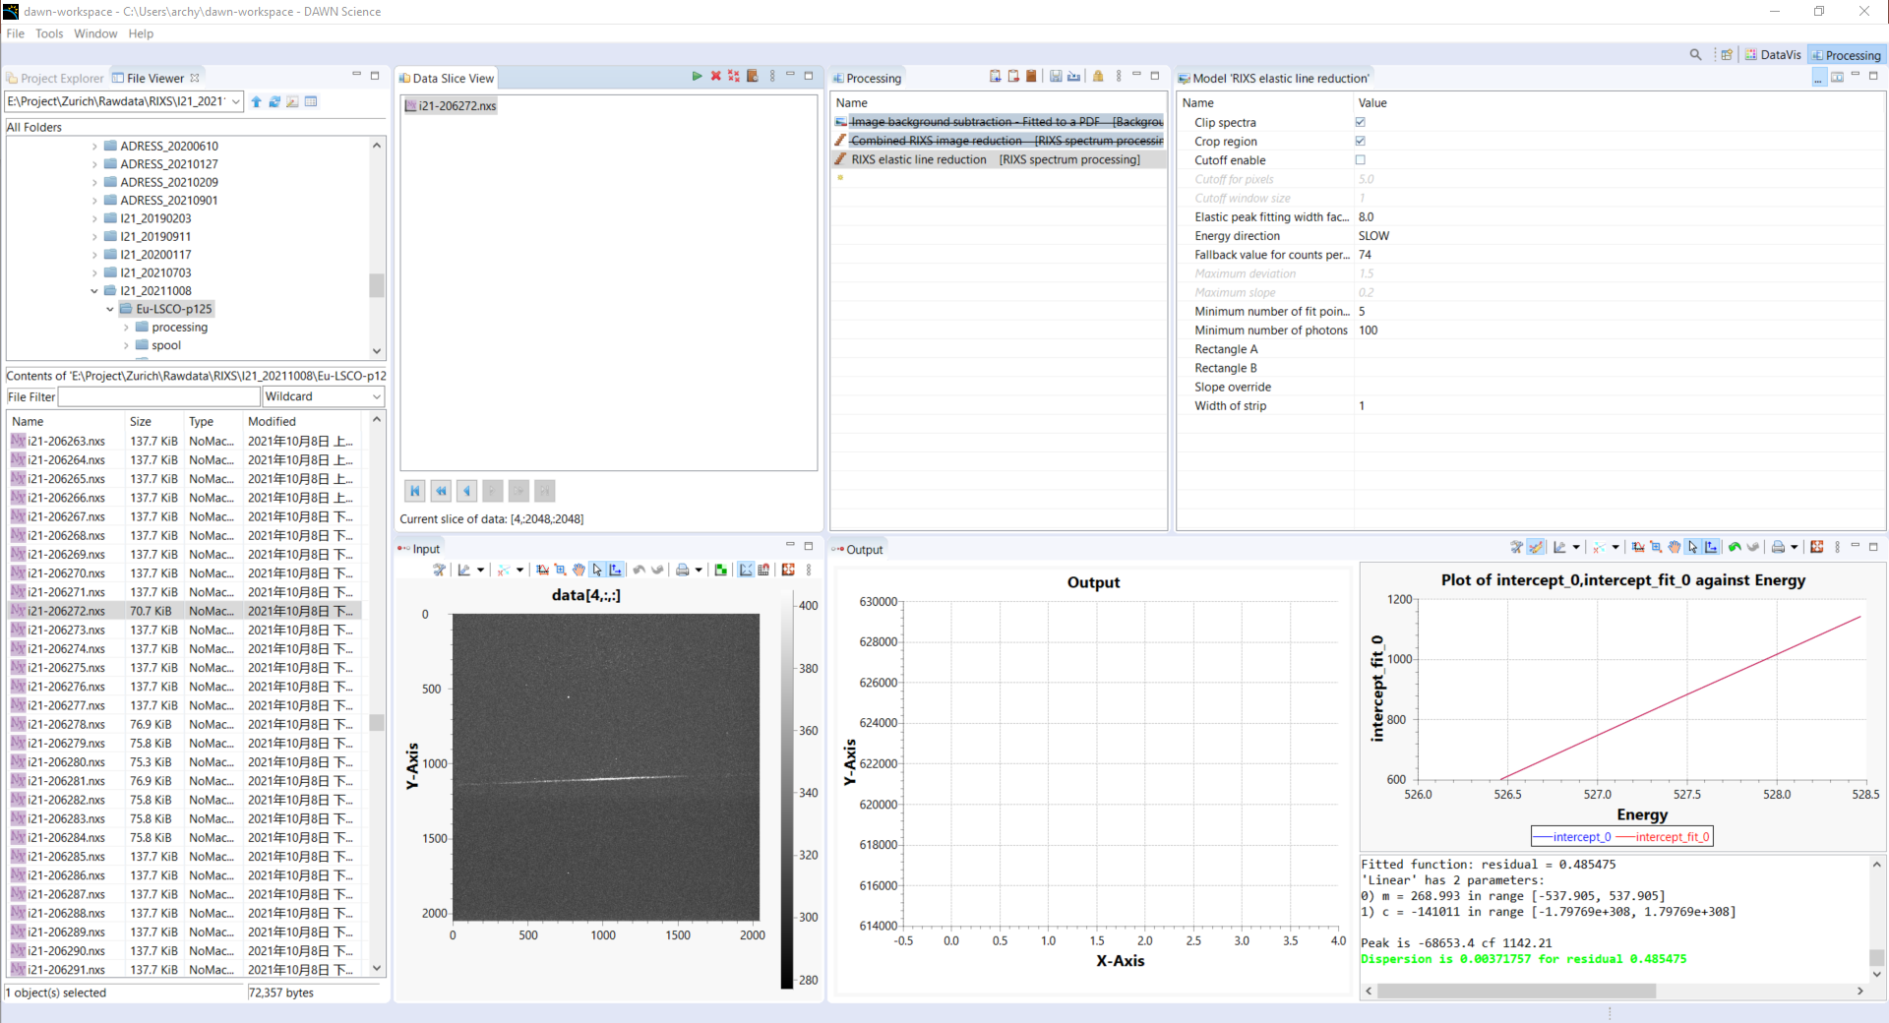
Dispersion and slope from #206272, phonon energy scan on C-tape
This is for the fast scans that did not take the C-tape. Save the processed elastic line data

Slide 4
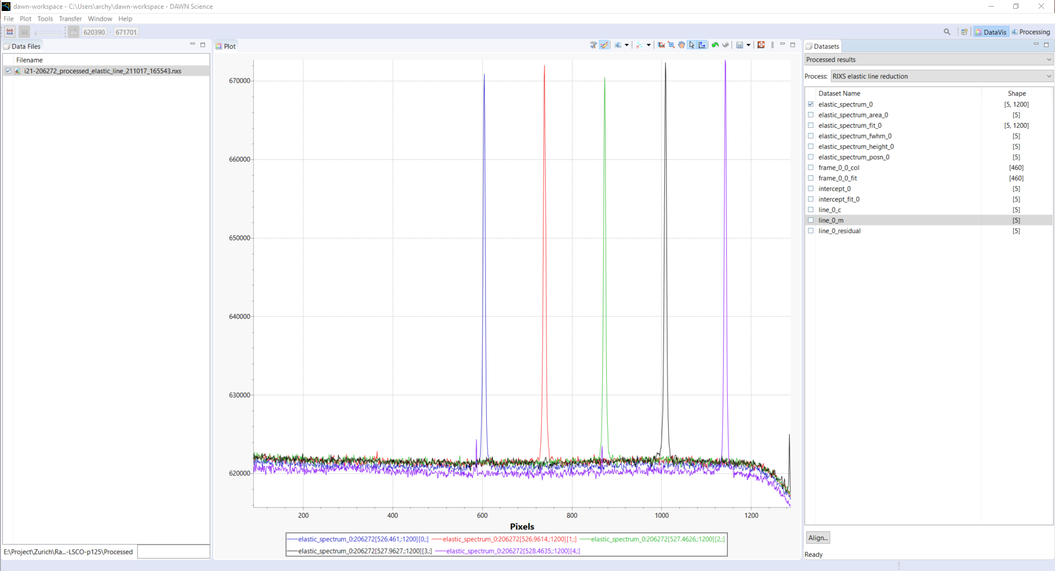
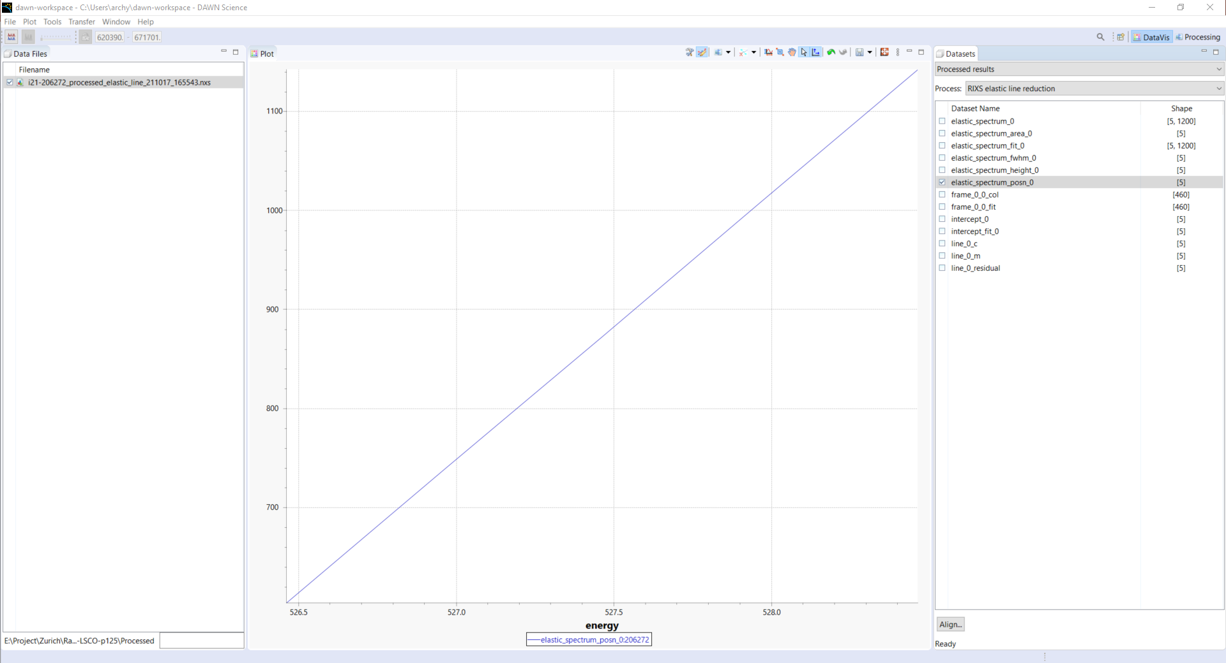
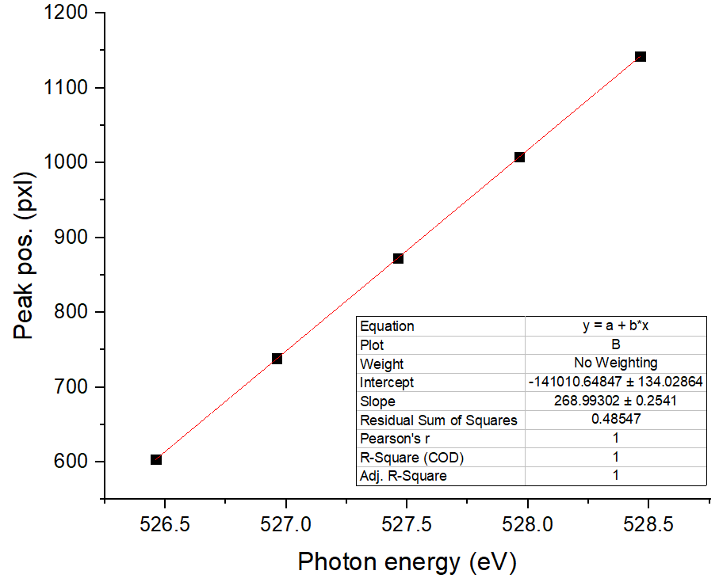
Dispersion = 0.0037176 eV/pxl, get elastic peak pos. at each energy, export the pos. from Dawn, then manually fit
#206272
Energy dispersion = 1/268.99302 = 0.0037176 eV/pxl

Slide 5
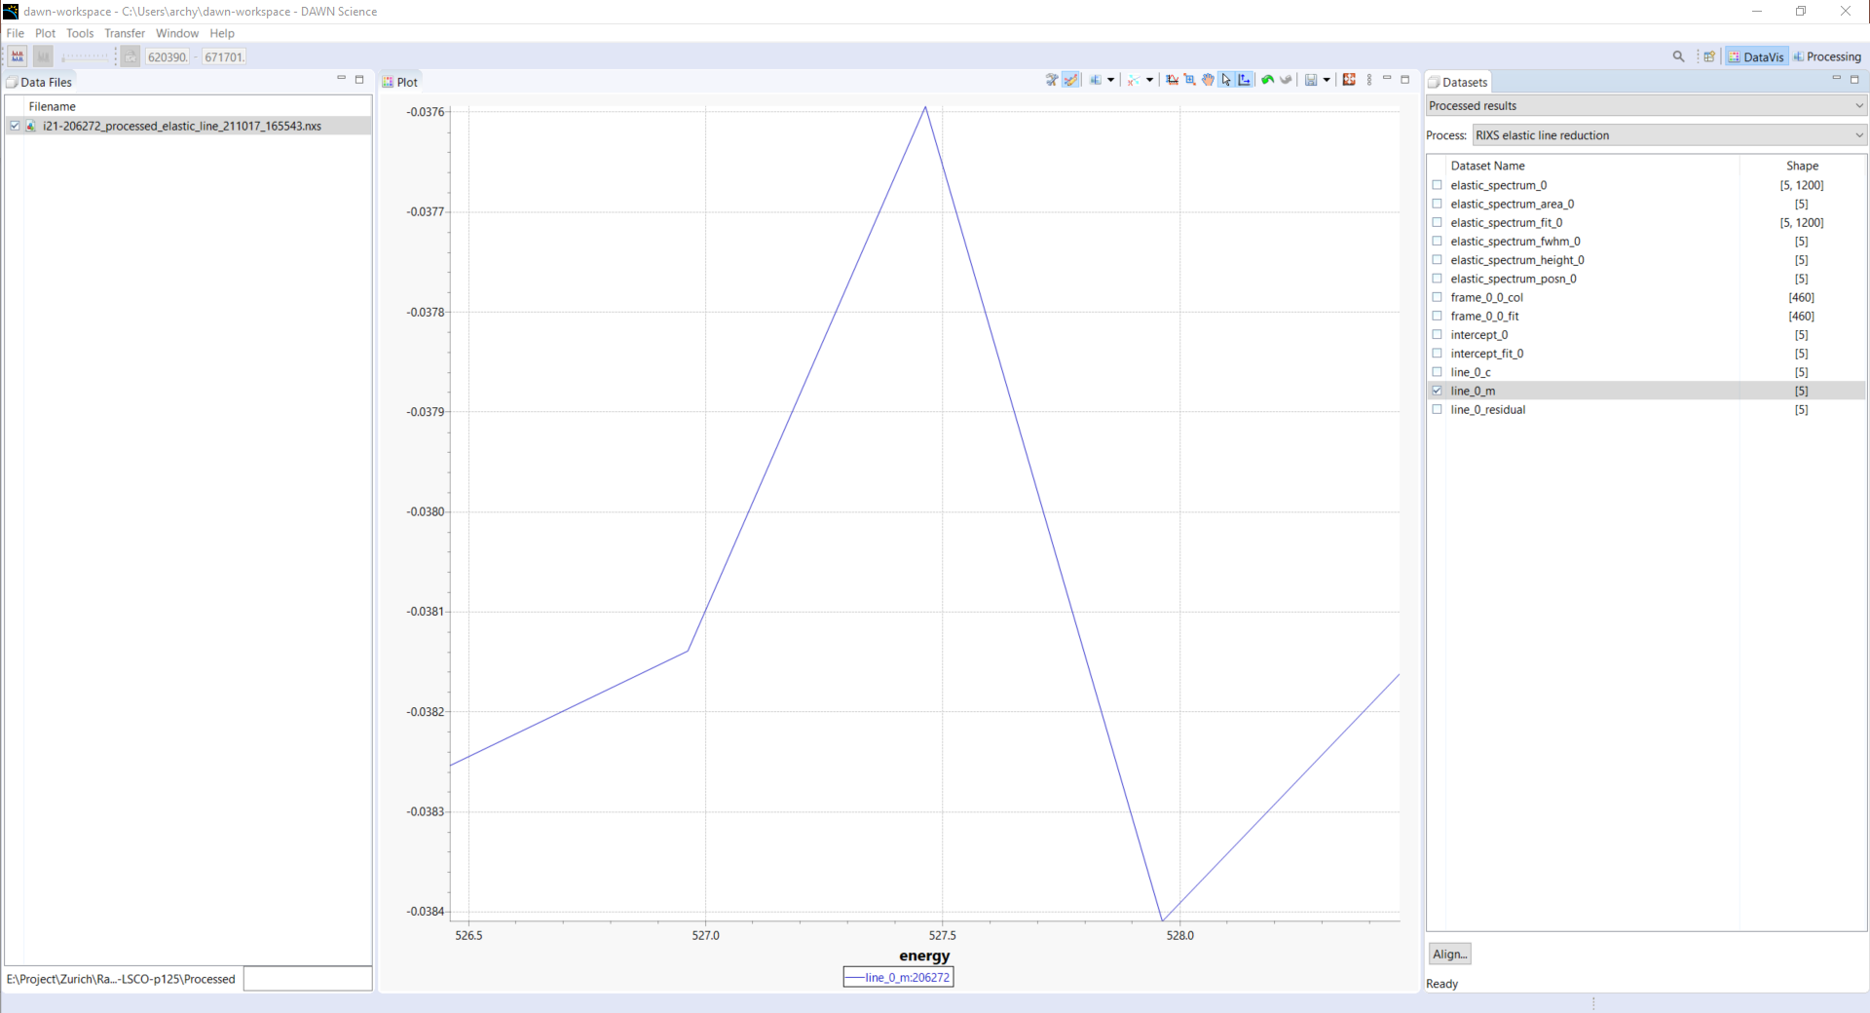
Slope, take the average = -0.0381
#206272

Slide 6
Calculate (h, k, l), (for fast scans)
Ep = 527.46; % photon energy
tth = 154; % scattering angle
lat_a = 3.79; % lattice parameters
lat_b = lat_a;
lat_c = 13.1;
theta0 = -0.94; % theta offset
phi = -6.4:0.5:3.6;
phi0 = -1.4;
theta = 27;
[qh,qk,ql] = q_cal_RIXS(Ep,tth,lat_a,lat_b,lat_c,theta,theta0,phi,phi0);
theta = theta';
phi = phi';
qh = qh';
qk = qk';
ql = ql';
qq = [phi,qh,qk];
Ep = 527.46; % photon energy
tth = 154; % scattering angle
lat_a = 3.79; % lattice parameters
lat_b = lat_a;
lat_c = 13.1;
theta0 = -0.94; % theta offset
phi = -1.4;
phi0 = -1.4;
theta = 15:0.5:40; % theta for quick scan
[qh,qk,ql] = q_cal_RIXS(Ep,tth,lat_a,lat_b,lat_c,theta,theta0,phi,phi0);
theta = theta';
qh = qh';
qk = qk';
ql = ql';
qq = [theta,qh,qk,ql];

Slide 7
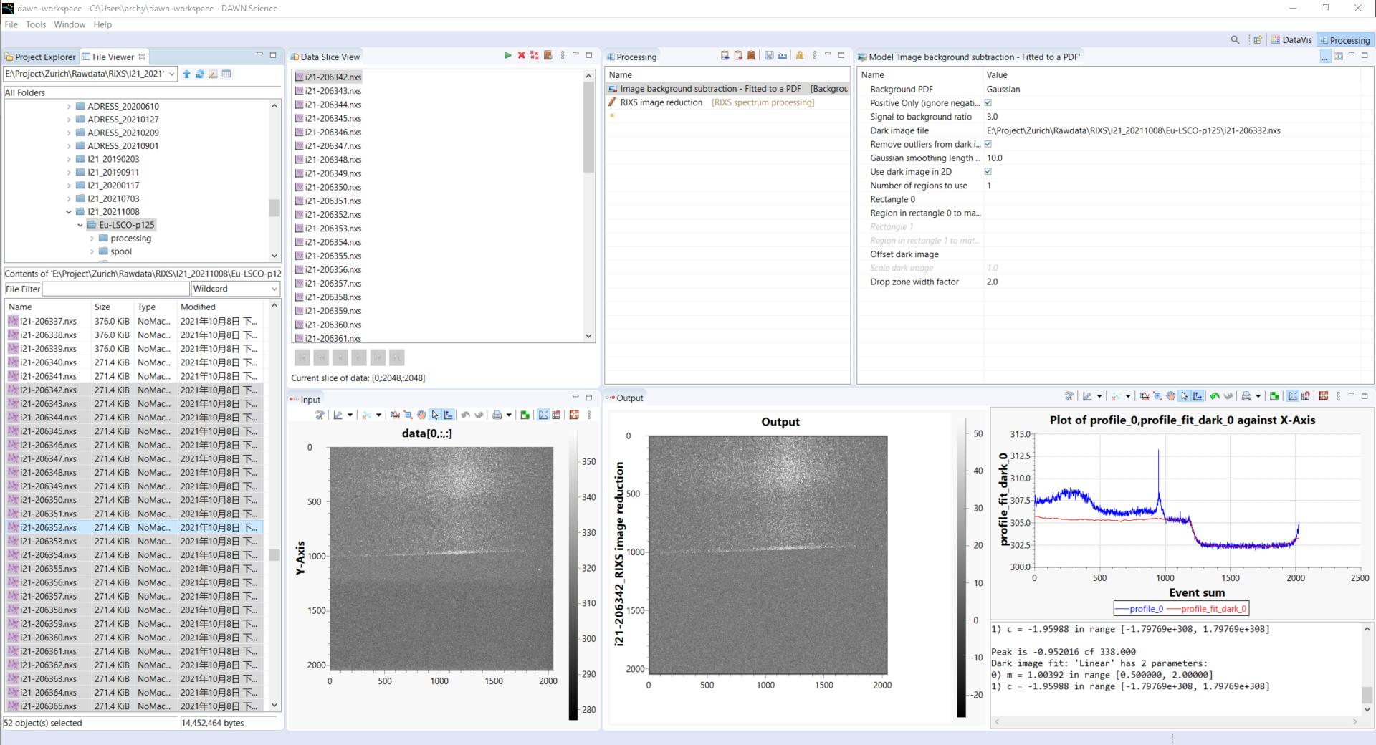
Fast h-scan (50 um slit) #[206342:206392]
Same setting for fast phi-scan (50 um slit) #[206393:206413,206416,206417]

Slide 8
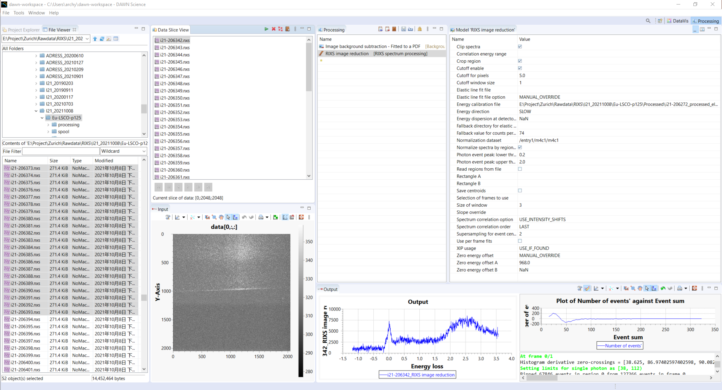
Fast h-scan (50 um slit) #[206342:206392]
Same setting for fast phi-scan (50 um slit) #[206393:206413,206416,206417]

Slide 9
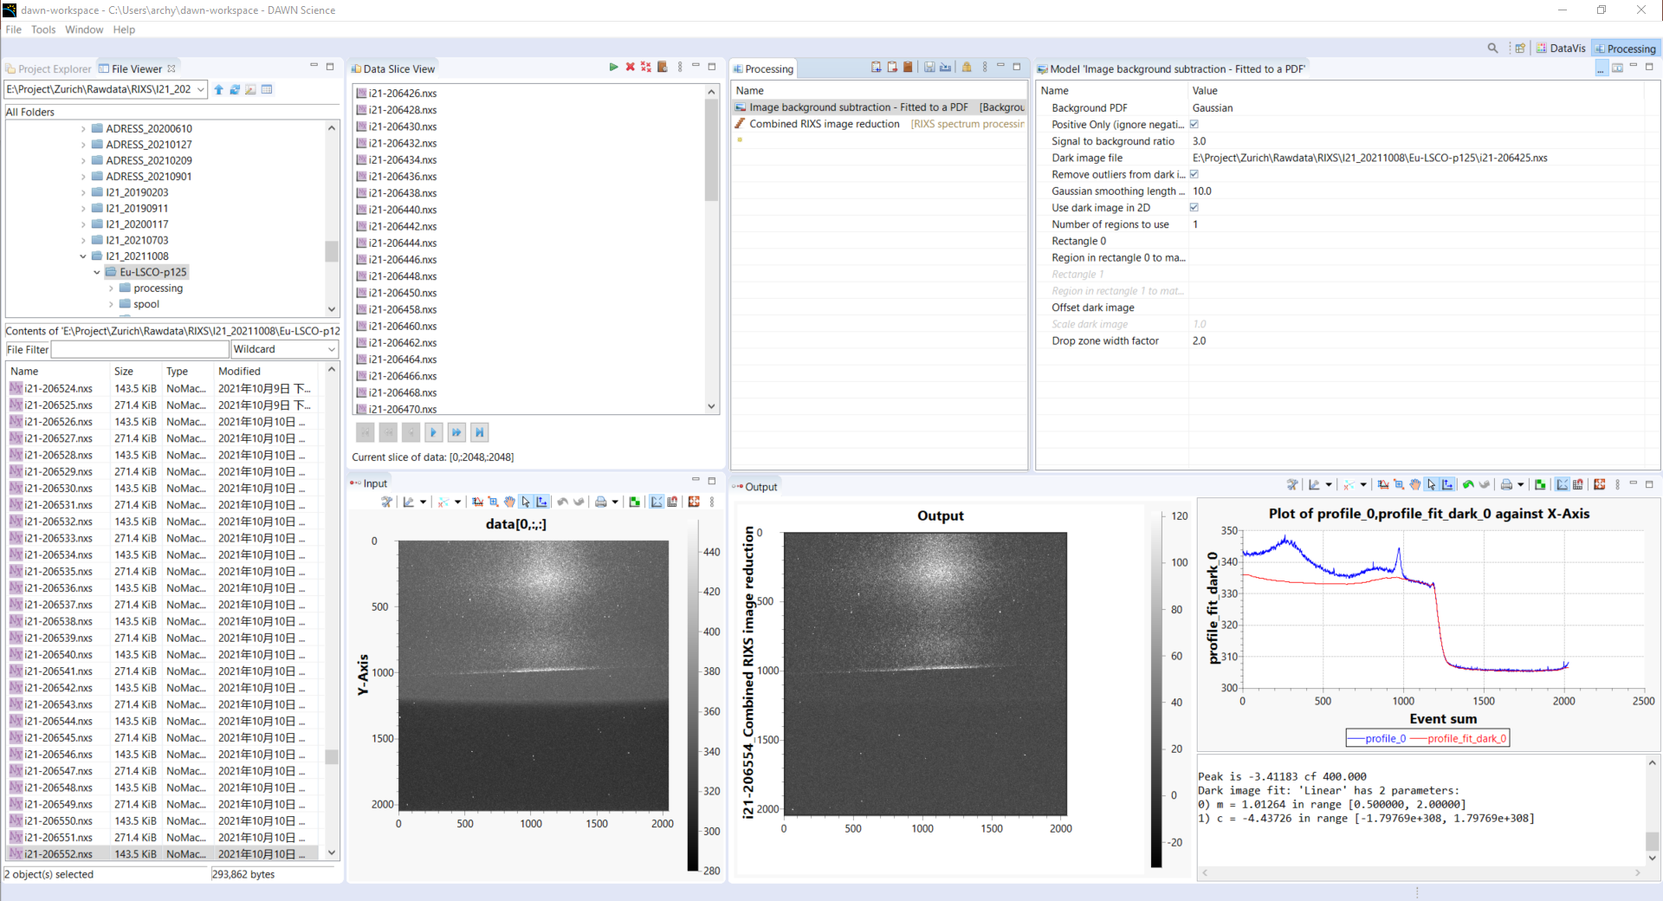
High-res Q-scan (20 um slit) 206426 until 206554

Slide 10
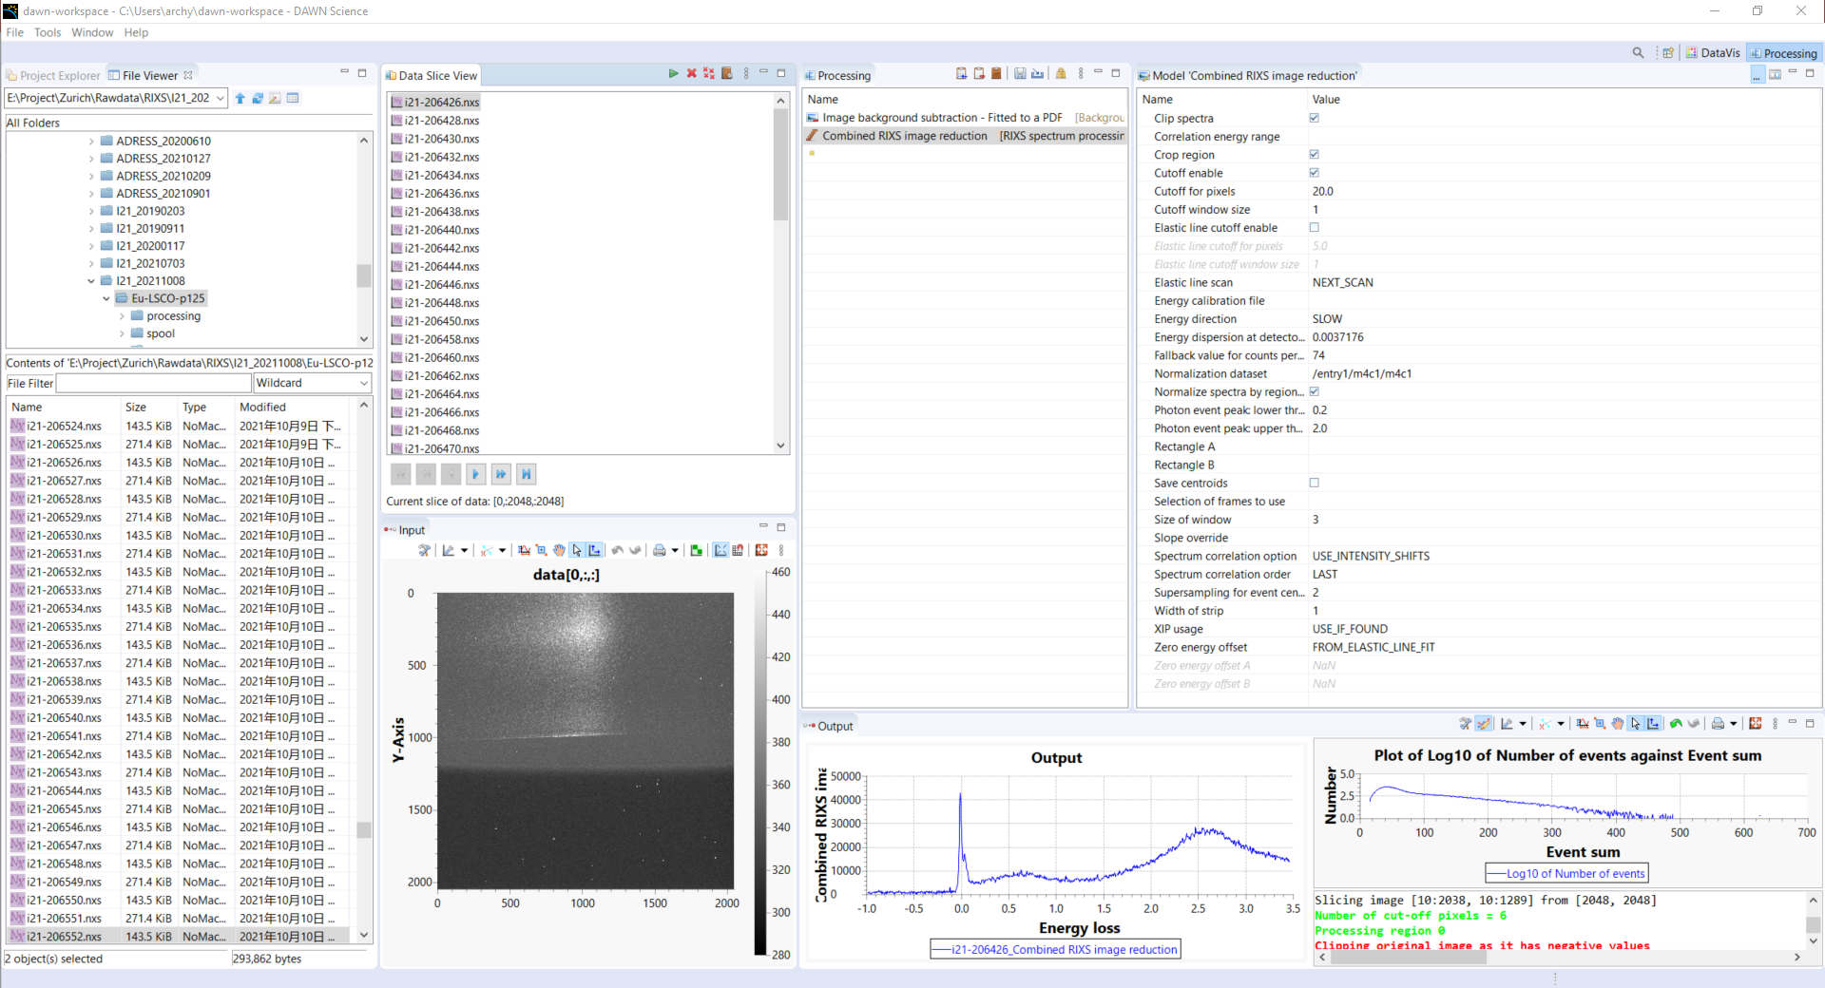
High-res Q-scan (20 um slit) 206426 until 206554
Correlation energy range: -0.1,0.1

Slide 11
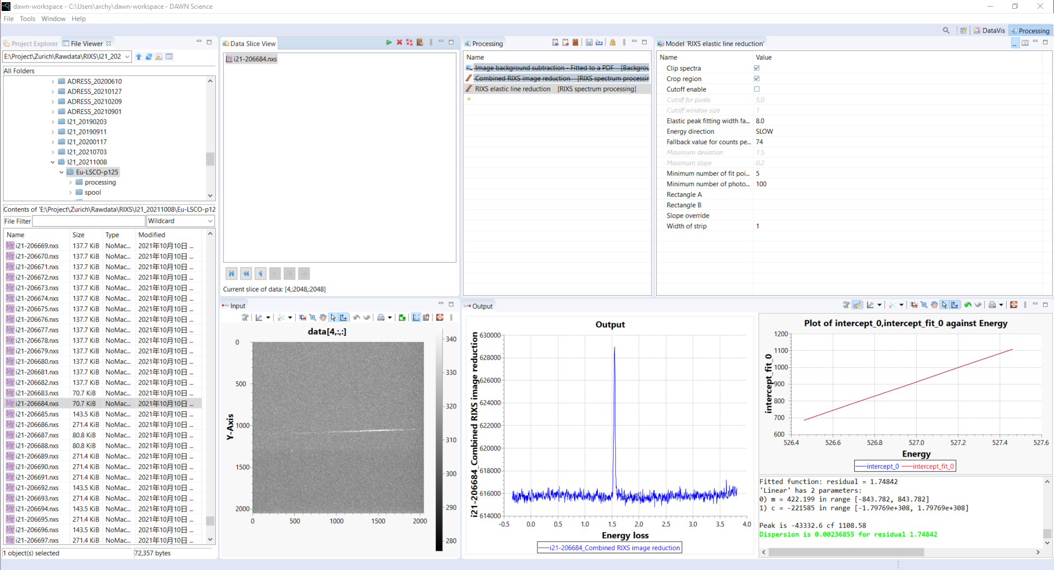
Dispersion and slope from #206684, phonon energy scan on C-tape
This is for the ultra-high-res data

Slide 12
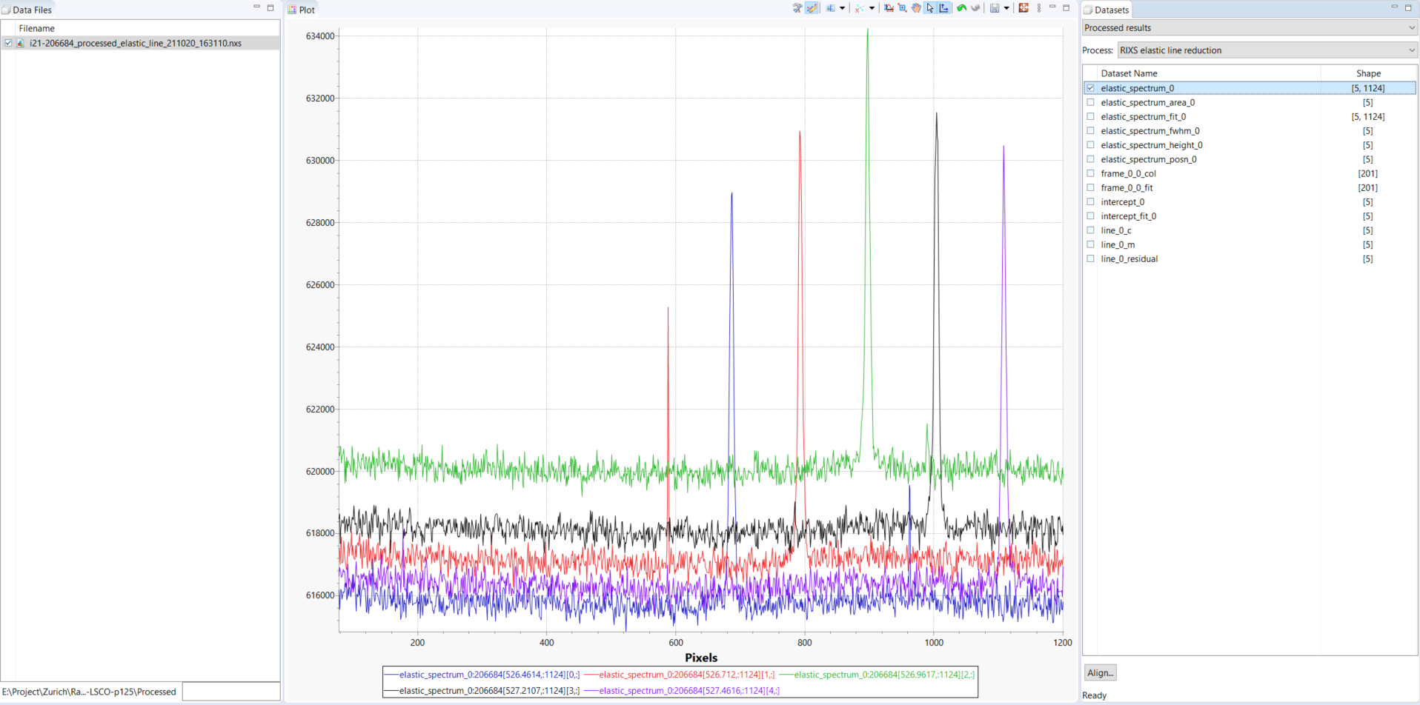
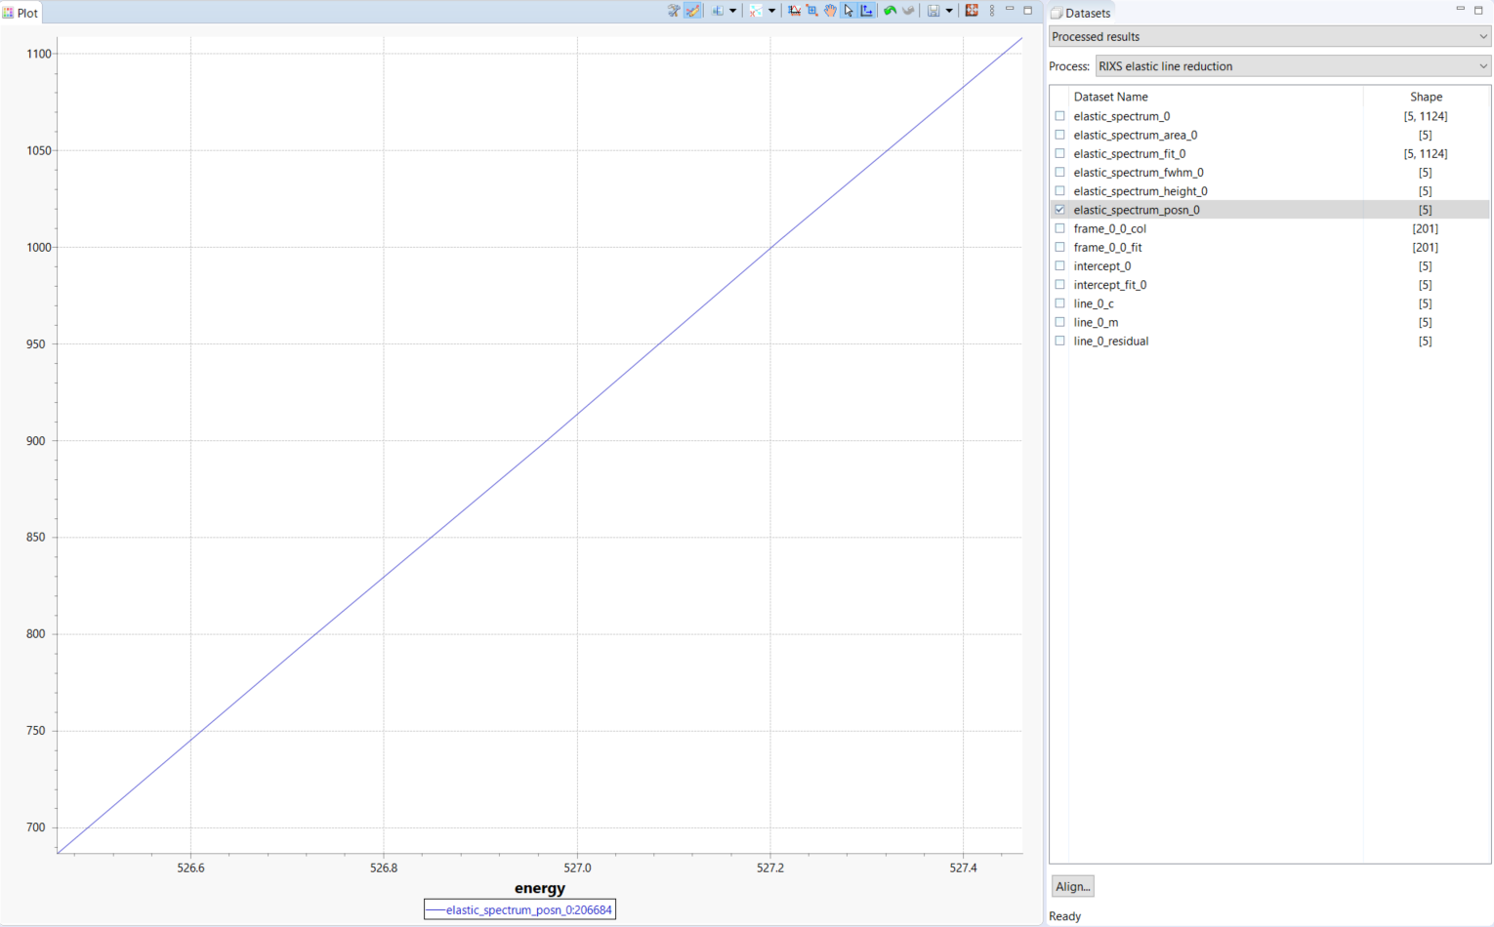
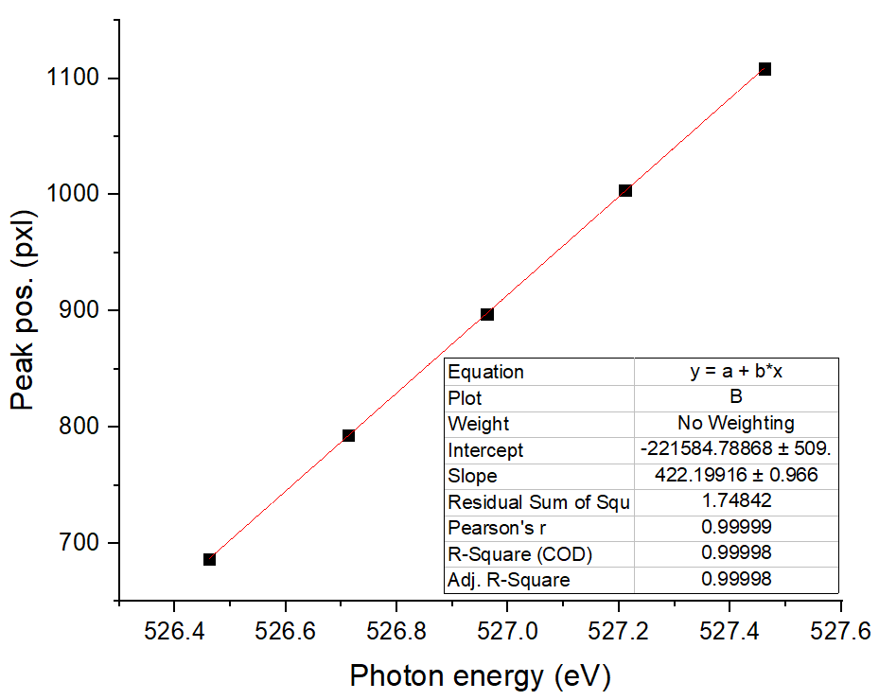
Dispersion = 0.00236855 eV/pxl, get elastic peak pos. at each energy, export the pos. from Dawn, then manually fit
This is for the ultra-high-res data
#206684
Energy dispersion = 1/422.19916 = 0.00236855 eV/pxl

Slide 13
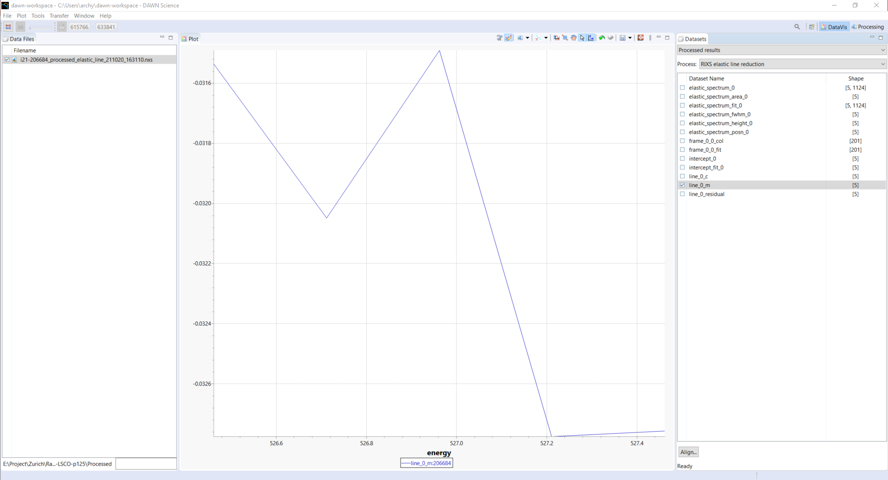
Slope, take the average = -0.03212
This is for the ultra-high-res data
#206684

Slide 14
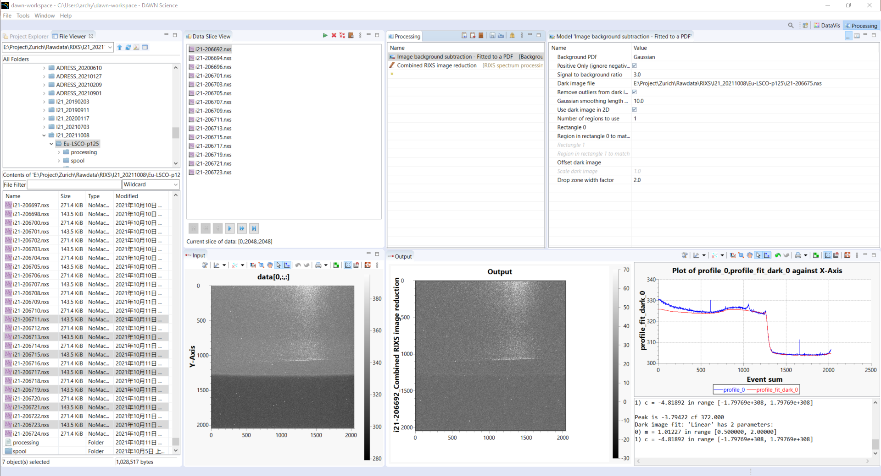
Ultra-high-res Q-scan (20 um slit) 206692 until 206723
This is for the ultra-high-res data

Slide 15
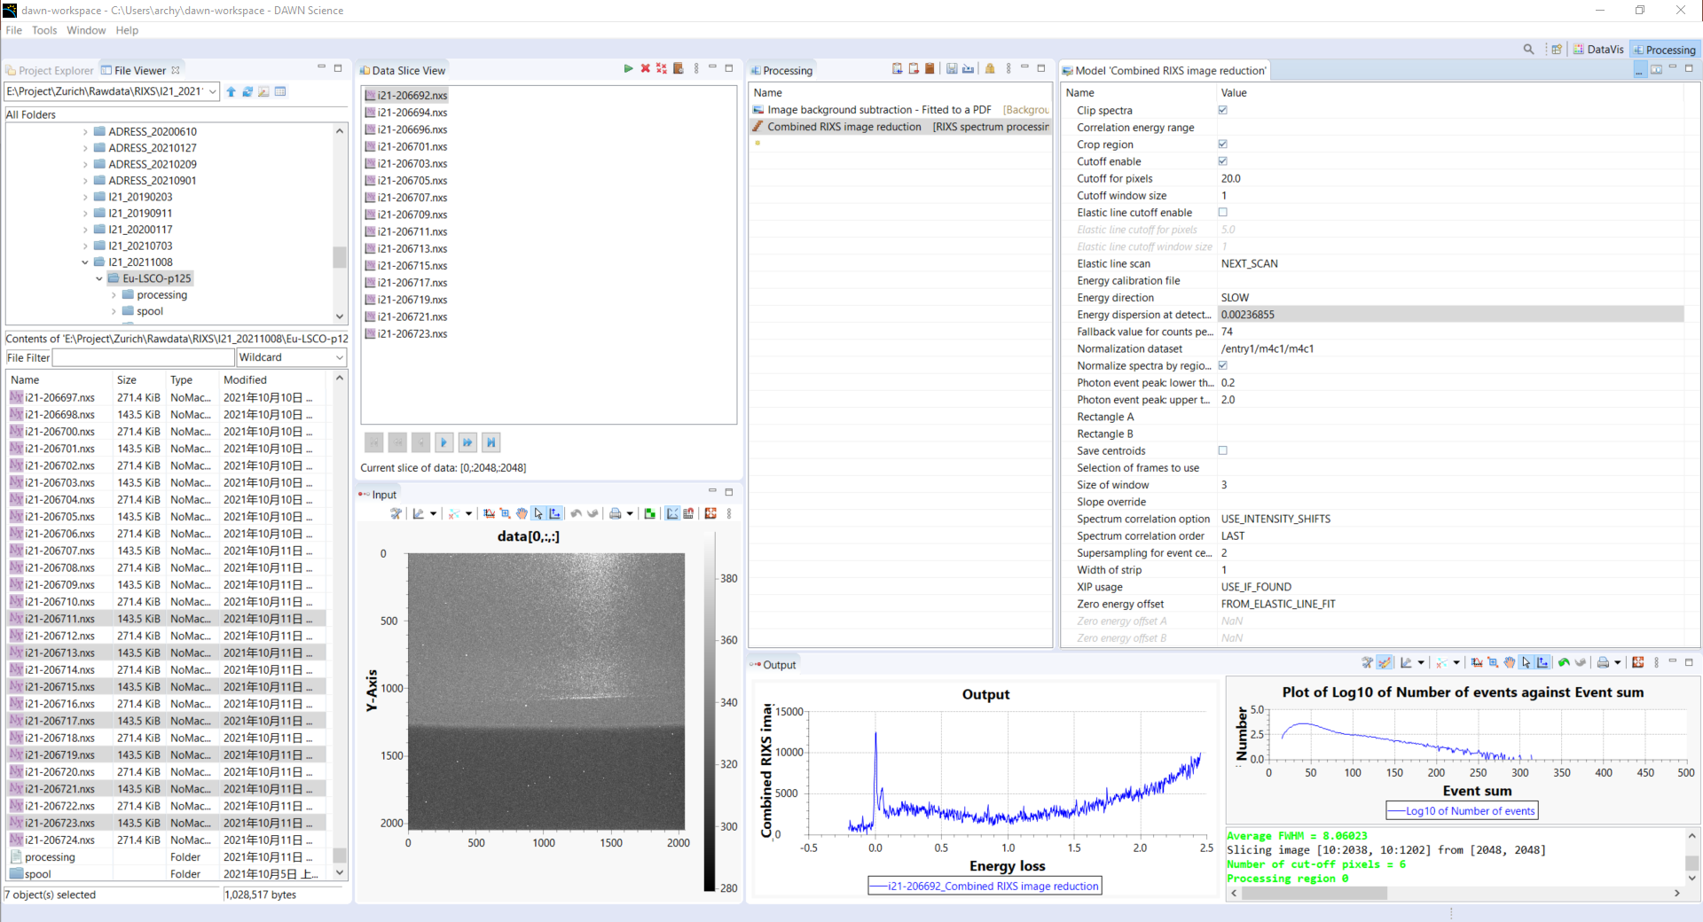
Ultra-high-res Q-scan (20 um slit) 206692 until 206723
This is for the ultra-high-res data
Correlation energy range: -0.1,0.1

Slide 16
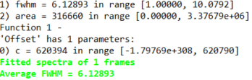
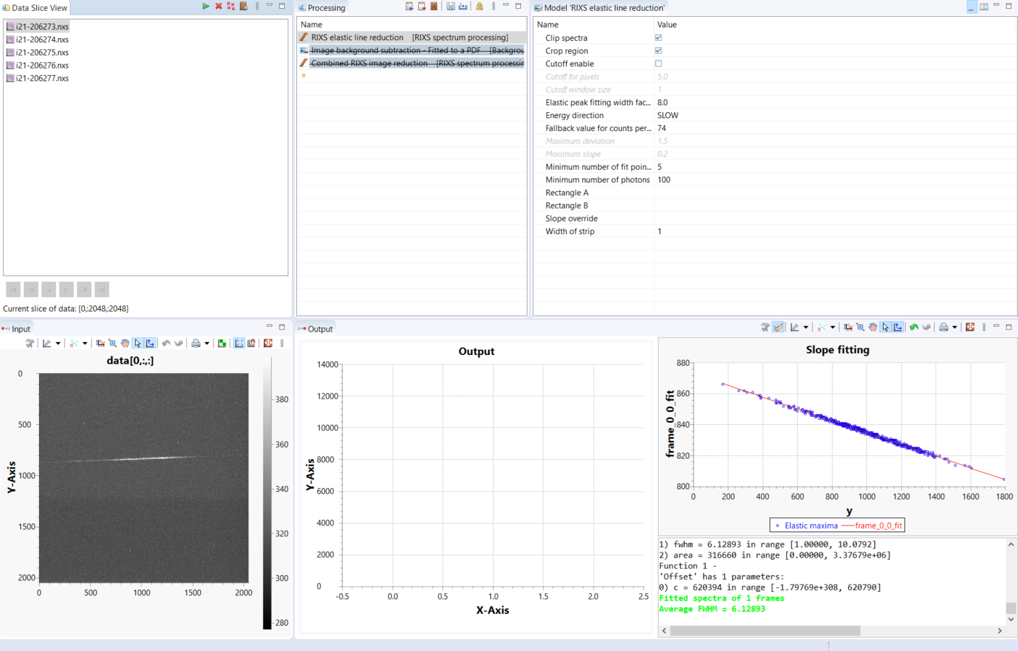
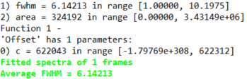
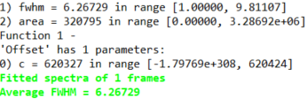
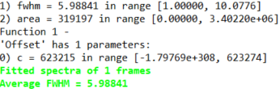
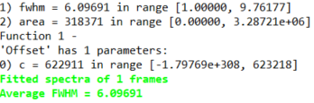
Determine resolution for high-res RIXS, #[206273:206277]
Average FWHM = 6.1247 pxl (from 5 C-tap scans)
Res = 6.12473 pxl* 0.0037176 eV/pxl = 22.77 meV
This is Gauss fitting, I will manually do Voigt fitting

Slide 17
Determine resolution for high-res RIXS, #[206273:206277]
Average FWHM = 6.1240375 pxl (from 5 C-tap scans)
Gauss + constant bkg
Res = 6.1240375 pxl* 0.0037176 eV/pxl = 22.77 meV

Slide 18
Determine resolution for high-res RIXS, #[206273:206277]
Average FWHM_V = 5.80439 pxl (from 5 C-tap scans)
Voigt + constant bkg
Res = 5.80439 pxl* 0.0037176 eV/pxl = 21.58 meV
Average FWHM_V = 5.80439 pxl
Average FWHM_G = 4.34800 pxl
Average FWHM_L = 2.445187 pxl
FWHM_V = 5.80 pxl
Res_V = 21.56 meV

Slide 19
Determine resolution for high-res RIXS, #[206273:206277]
Combine FWHM = 6.2884684 pxl (from 5 C-tap scans)
Gauss + constant bkg
Res = 6.2884684 pxl* 0.0037176 eV/pxl = 23.378 meV
Combine slightly broadens elastic line?

Slide 20
Determine resolution for high-res RIXS, #[206273:206277]
Combine FWHM_V = 5.97946 pxl (from 5 C-tap scans)
Voigt + constant bkg
Res = 5.97946 pxl* 0.0037176 eV/pxl = 22.229 meV
FWHM_V = 5.97946 pxl
FWHM_G = 4.53899 pxl
FWHM_L = 2.43405 pxl
Res_V = 22.229 meV
FWHM_G = 16.874 meV
FWHM_L = 9.0488 meV
Combine slightly broadens elastic line?

Slide 21
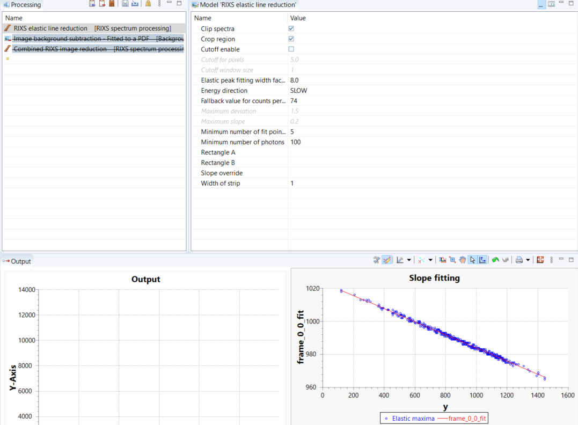
Fit all C-tape data for high-res RIXS
Voigt + constant bkg
21K: [206427:2:206451],
63K: [206459:2:206483],
104K: [206490:2:206514,205553,206555],
155K: [206521,206525:2:206551]
Process with Dawn then
“stp1p0_high_res_ctape”
Fit every ctape save result
disp = 0.0037176 eV/pxl

Slide 22
Fit all C-tape data for ultrahigh-res RIXS
Voigt + constant bkg
22K: [206693:2:206697,206702],
63K: [206704:2:206710],
104K: [206712:2:206718],
155K: [206720:2:206724]
Process with Dawn then
“stp1p1_ultrahigh_res_ctape”
Fit every ctape save result
disp = 0.00236855 eV/pxl

Slide 23
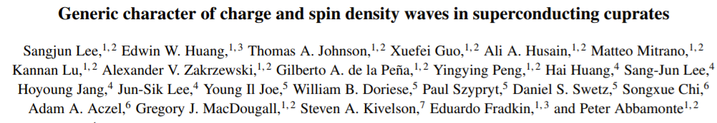
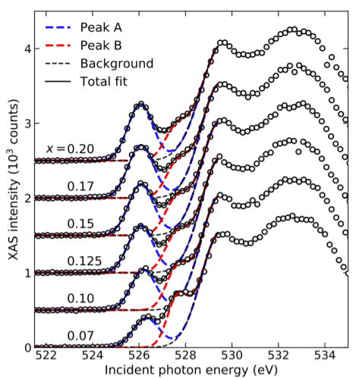

Slide 24
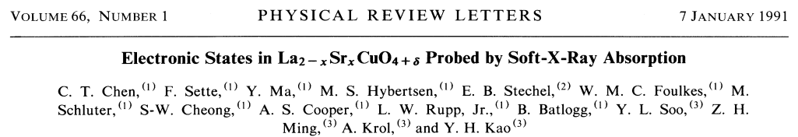
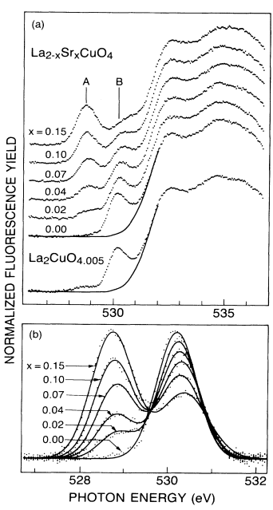
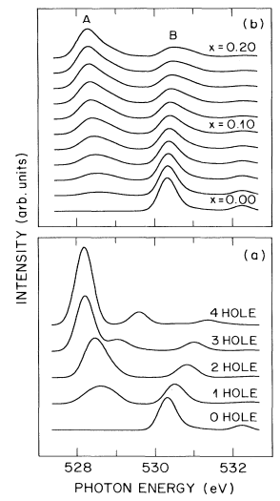
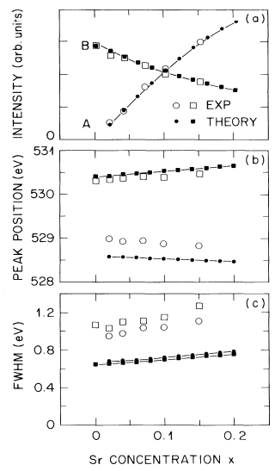

Slide 25
Grazing-in (norm. to m4c1)
Grazing-in XAS (norm. to m4c1)
LV (E//ab)
LH (E//c)
p_{x,y}
p_{z}

Slide 26
Elastic line fitting of C-tape for all temperatures
High-res
ultrahigh-res

Slide 27
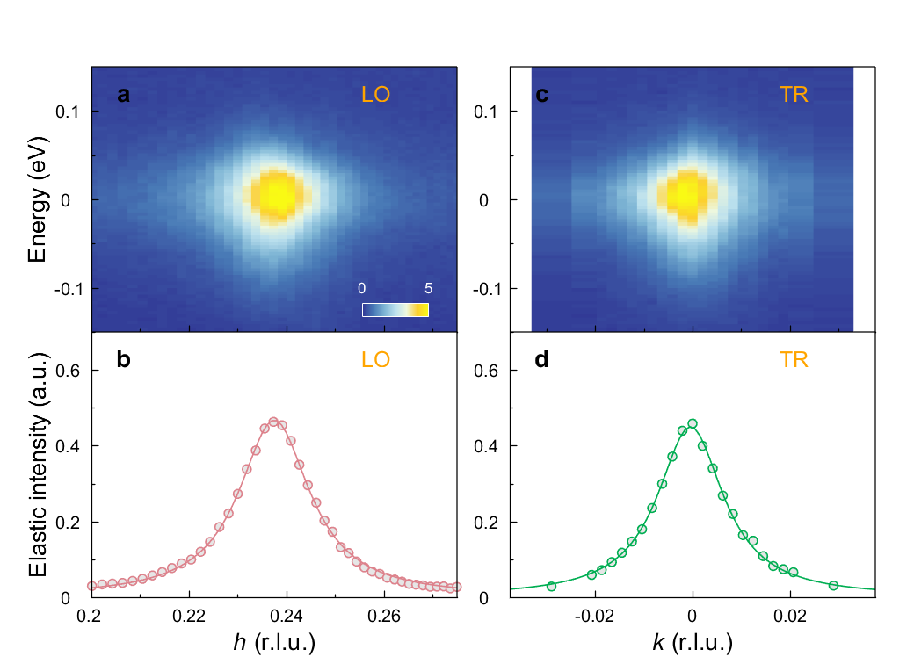
Elastic intensity from fast Q-scan
fwhm = 0.09456; % estimated from #206366 Qcdw with strong elastic line

Slide 28
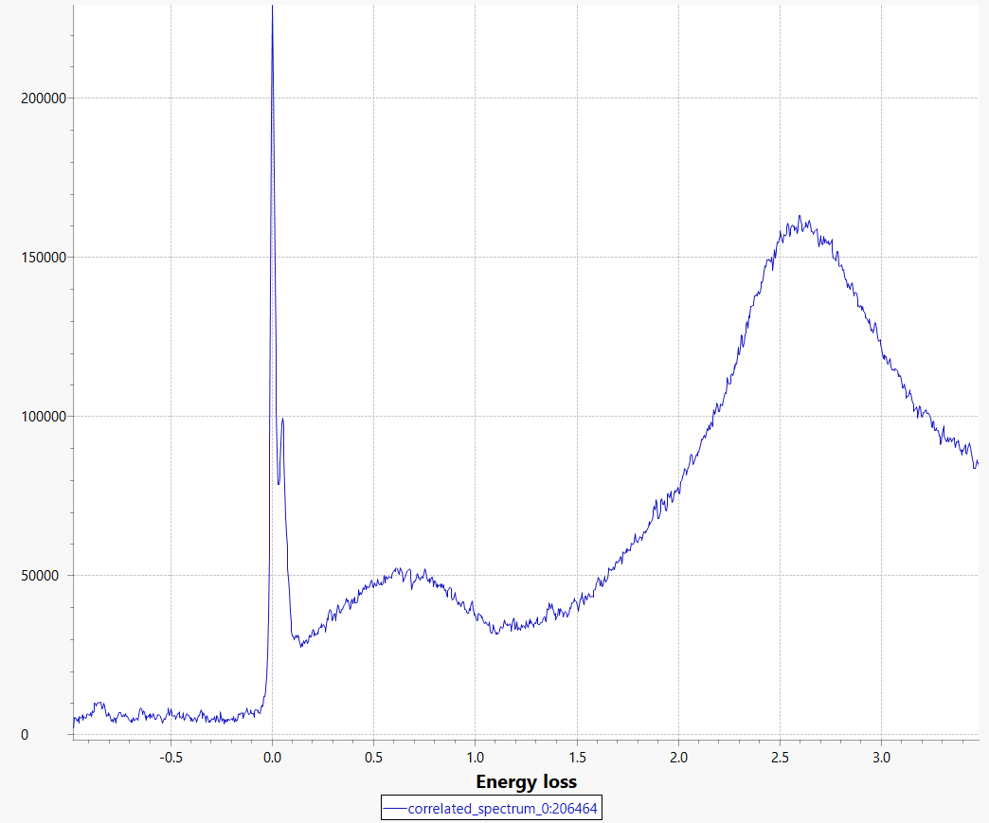
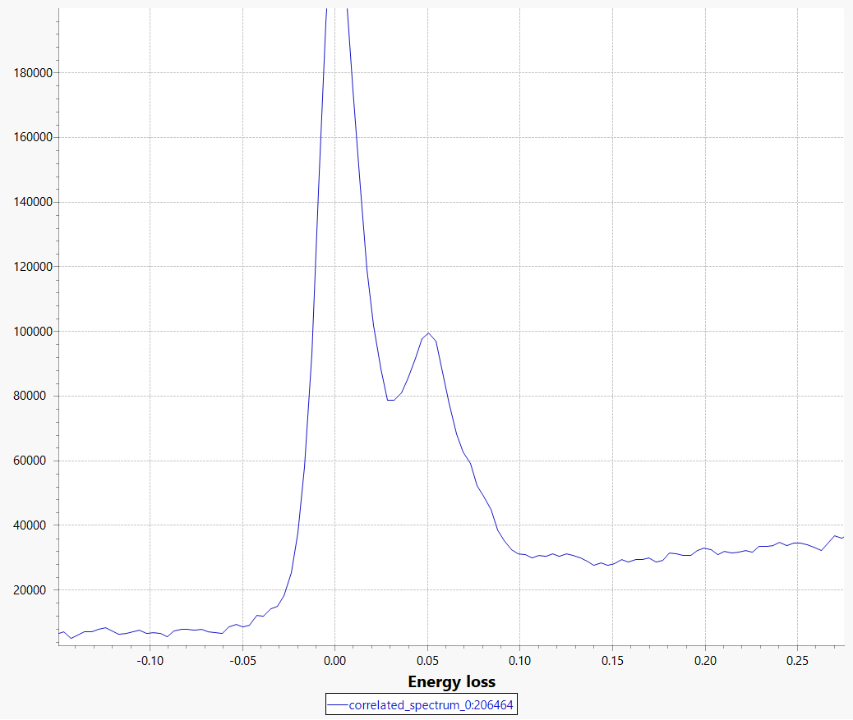

Slide 29
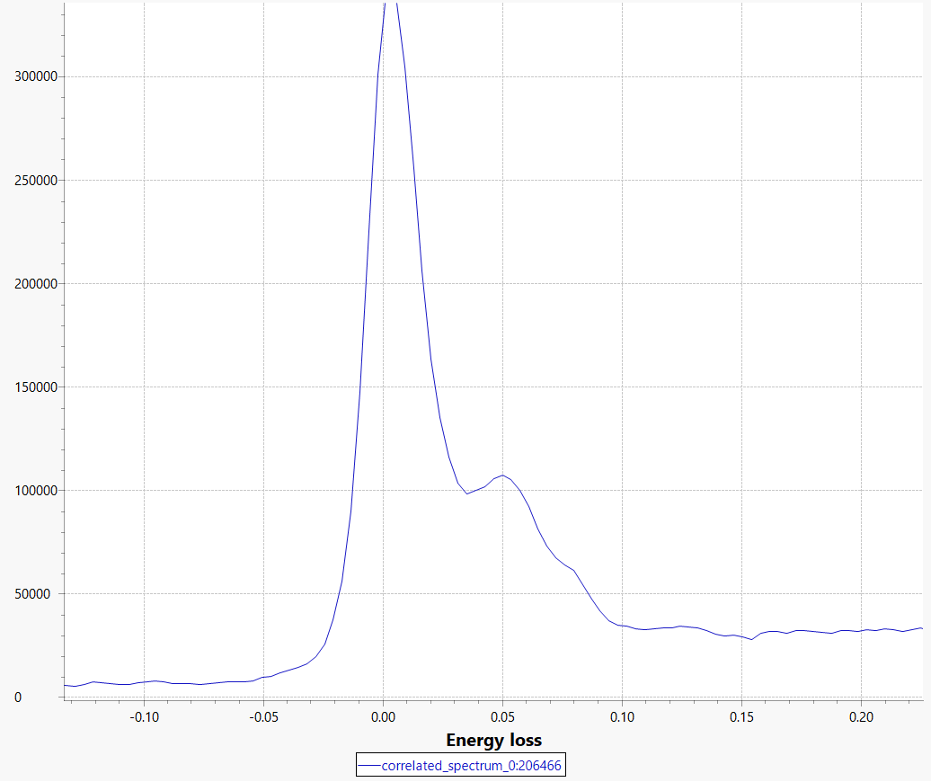

Slide 30
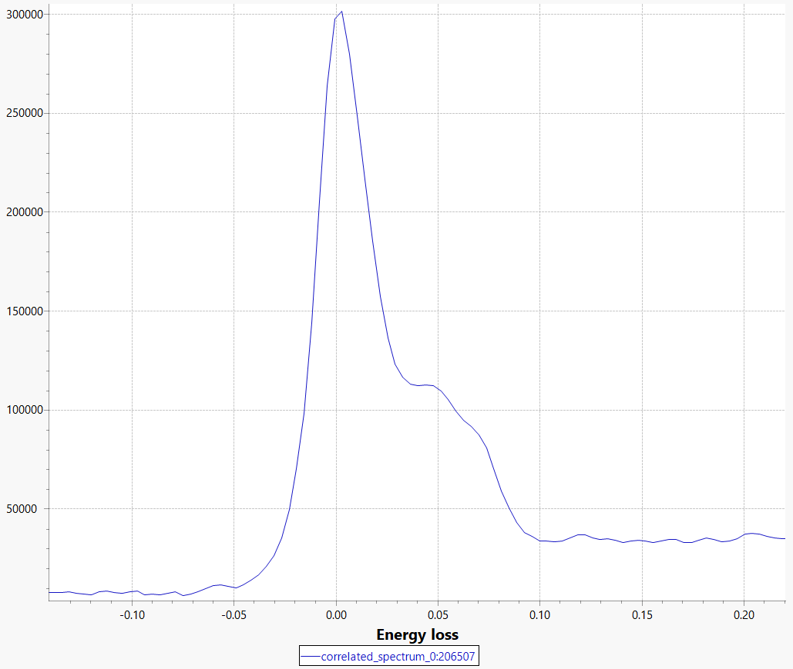
T104, h0.26

Slide 31
Fit2, Voigt+4Guass (width fixed to res)

Slide 32
Fit2, Voigt+4Guass (width fixed to res)
Bose factor corrected

Slide 33
Fit2, Voigt+4Guass (width fixed to res)

Slide 34
Fit2, Voigt+4Guass (width fixed to res)
Bose factor corrected (use Gauss peak energy)
Should not call y as intensity any more

Slide 35
Fit3, 5Voigt (width fixed to res)

Slide 36
Fit3, 5Voigt (width fixed to res)
Bose factor corrected, refit peaks with 4Voigt

Slide 37
Fit2, 5Voigt (width fixed to res)

Slide 38
Fit2, 5Voigt (width fixed to res)
Bose factor corrected, refit peaks with 4Voigt

Slide 39
Fit2, 5Voigt (width fixed to res)

Slide 40
Fit2, 5Voigt (width fixed to res)
Bose factor corrected, refit peaks with 4Voigt

Slide 41
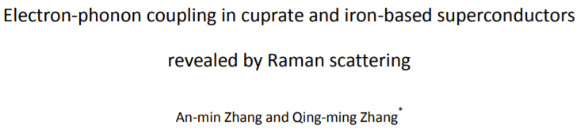
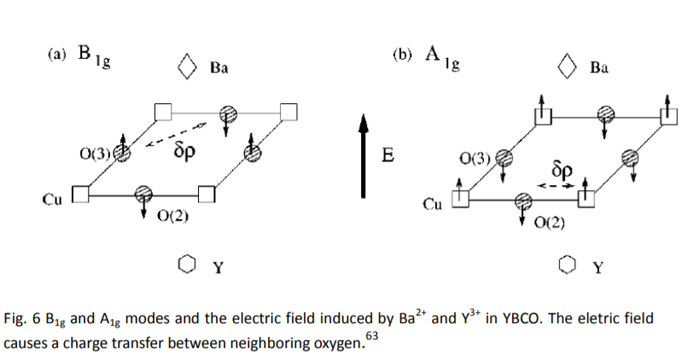
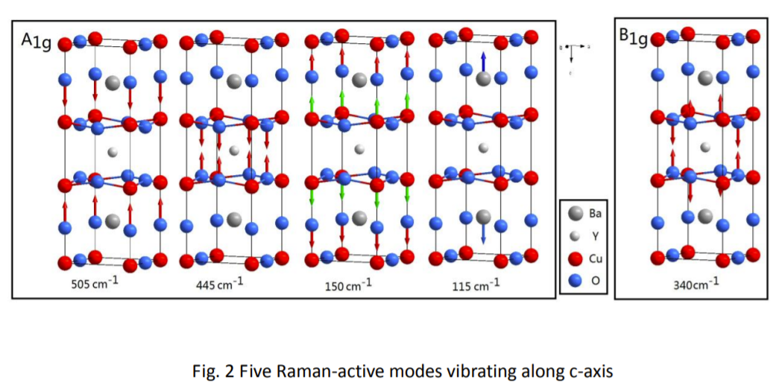

Slide 42
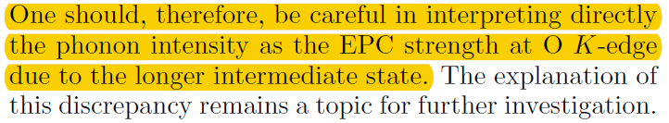
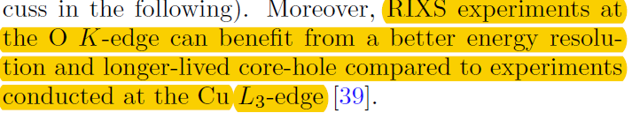
Why O K-edge has a longer core-hole life time?
Prior RIXS studies of EPC in the 2D cuprates have
focused largely on the Cu L3-edge [30, 35, 37]. How-
ever, it has been established that the bands that cross
the Fermi level in doped cuprates have significant oxy-
gen 2px;y orbital character [38]. Moreover, the phonons
believed to be most relevant to pairing in the cuprates
are the optical oxygen modes [6, 17]. It is, therefore, desirable to also study the EPC at the O K-edge in these
materials.
Compare to the softening of acoustic mode from IXS measurements?
To the BS mode
To establish that it is not from EPC
And the width is broader then the CDW order
The RIXS process at this edge involves the
1s-2p transition, so that in the intermediate state the
charge perturbation mostly involves the electron in a 2p
orbital
Y. Peng et al., arXiv:2111.05533.

Slide 43
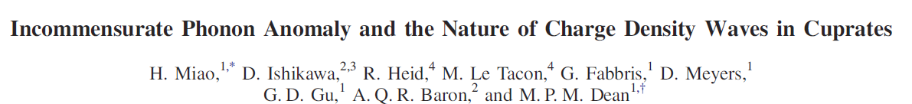
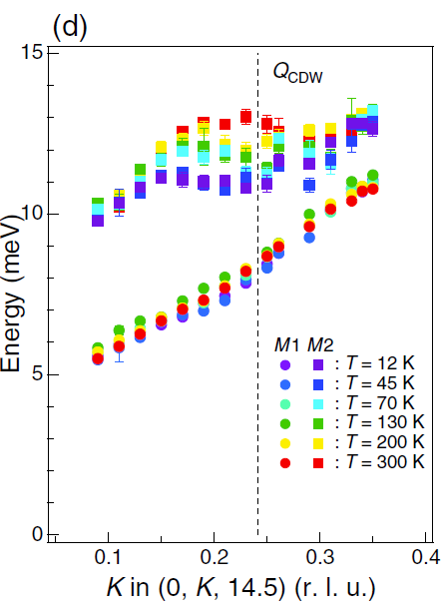
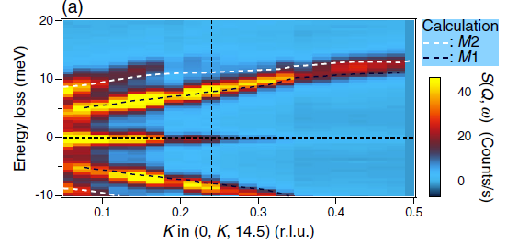
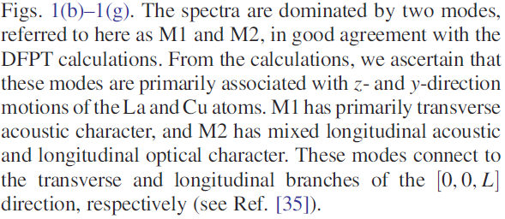

Slide 44
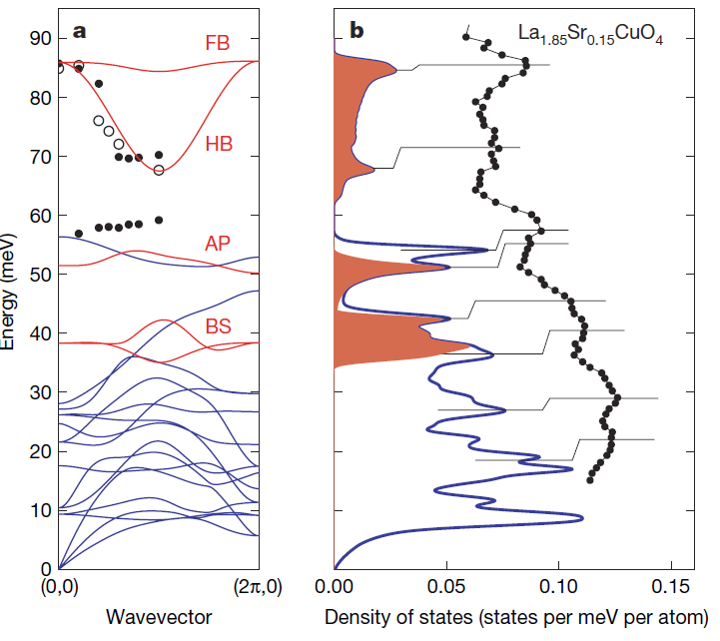

Slide 45
Experimental probe of EPC
ARPES probes fermionic, the phonon Q-dep is integrated.
NS/IXS relies on lifetime analysis
RIXS as a new route to probe EPC. Phonon inten. EPC and interference with charge
Cu L-edge has been applied widely.
Strong coupling mode: BS, what about lower-energy phonons?
Buckling mode? Bi PNAS paper – Buckling mode interference
What about in stripe ordered compound?

Slide 48

Coupling of Charge and Lattice Dynamics in Eu-La_{2-x}Sr_{x}CuO_{4,} x=1/8
An O K-edge Resonant Inelastic X-ray Scattering (RIXS) Study
Qisi Wang
Johan Chang Group
Group meeting, Jan. 26th, 2022

Slide 49
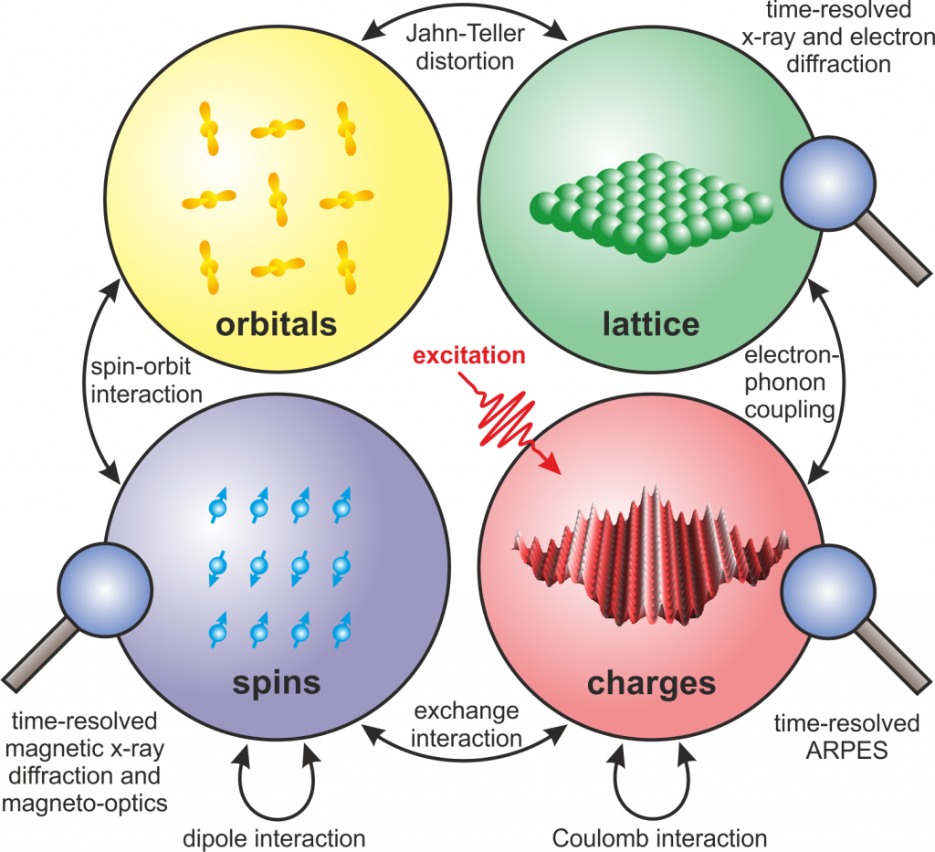
Elementary degrees of freedom in quantum materials and their couplings
Resonant x-ray
Scattering / ARPES
Neutron/x-ray scattering
Neutron scattering
Resonant x-ray
Scattering
https://pc.fhi-berlin.mpg.de/docm/research

Slide 50
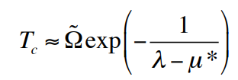
Elementary degrees of freedom in quantum materials and their couplings
e-phonon coupling: renormalization of electrons by phonons
Resonant x-ray
Scattering / ARPES
Neutron/x-ray scattering
BCS superconductivity
High-T_{c} ?
Stripe order ? ...
Neutron scattering
Resonant x-ray
Scattering
https://pc.fhi-berlin.mpg.de/docm/research

Slide 51
Elementary degrees of freedom in quantum materials and their couplings
Resonant x-ray
Scattering / ARPES
Neutron/x-ray scattering
M(k,q) depends on fermionic k + bosonic q
Neutron scattering
Resonant x-ray
Scattering
https://pc.fhi-berlin.mpg.de/docm/research

Slide 52
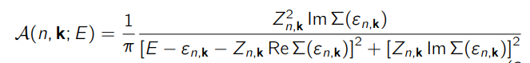
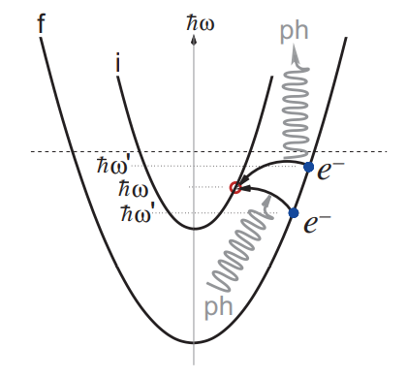
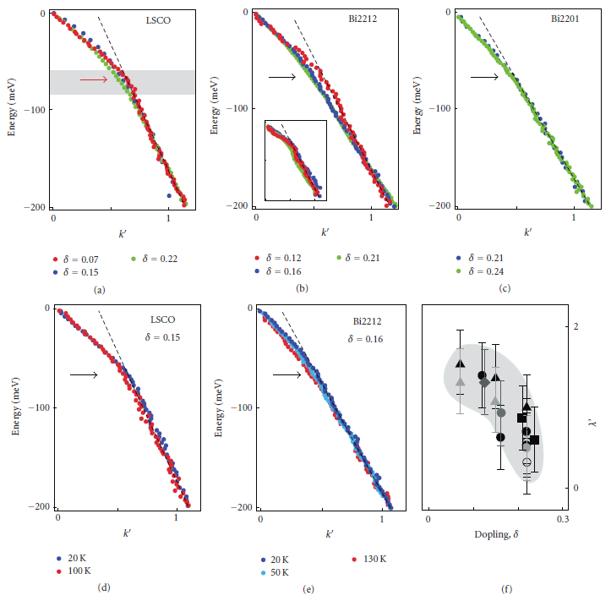
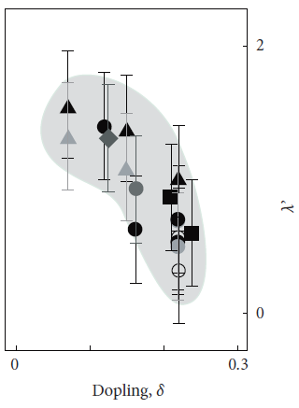



ARPES as a probe of e-ph coupling
Inter-band e-ph
scattering
ARPES kink
EPC constant
Hofmann et al., New J. Phys. 11, 125005 (2009)
Lanzara et al., Nature, 412, 510 (2001)

Slide 53
ARPES as a probe of e-ph coupling
Inter-band e-ph
scattering
ARPES kink
EPC constant
Which bosonic mode? Phonon? Magnon?
Which phonon?
Hofmann et al., New J. Phys. 11, 125005 (2009)
Lanzara et al., Nature, 412, 510 (2001)
q-dependence of M(k,q)?

Slide 54


RIXS as a probe of e-ph coupling
2p→3d RIXS process
Scattering geometry
RIXS phonon
Defining parameters for RIXS phonon intensity
i) Electron-phonon coupling
ii) Core-hole lifetime
Braicovich et al., PRR 2, 023231 (2020)
Wang et al., Sci. Adv. 7, eabg7394 (2021)

Slide 55



L-edge RIXS results on Eu-LSCO: e-ph coupling enhanced in the LTT charge ordered phase
Bond-stretching mode
LTO: low-temperature orthorhombic
Q-dependent e-ph coupling peaks near Q_{CDW}
LTT: low-temperature tetragonal – ideal structure for stripe order?
Wang et al., Sci. Adv. 7, eabg7394 (2021)

Slide 56
Why O-K RIXS for e-ph coupling study
Pros:
Bands across the Fermi level of doped cuprates have significant O 2p_{x,y} character
LSCO XAS
Chen PRL 66, 104 (1991)

Slide 57


Why O-K RIXS for e-ph coupling study
Pros:
Bands across the Fermi level of doped cuprates have significant O 2p_{x,y} character
Low-energy phonons are predicted to strongly coupled to charge order
LSCO XAS
Chen PRL 66, 104 (1991)
Forgan et al., Nat. Comm. 6, 10064 (2015)
Anazai Sci. Rep. (2017)

Slide 58

Why O-K RIXS for e-ph coupling study
Pros:
Bands across the Fermi level of doped cuprates have significant O 2p_{x,y} character
Low-energy phonons are predicted to strongly coupled to charge order
Low-energy phonons could possibly influence pairing
LSCO XAS
Chen PRL 66, 104 (1991)
Forgan et al., Nat. Comm. 6, 10064 (2015)
Anazai Sci. Rep. (2017)
Johnston PRB 82, 064513 (2010)

Slide 59
Why O-K RIXS for e-ph coupling study
Pros:
Bands across the Fermi level of doped cuprates have significant O 2p_{x,y} character
Low-energy phonons are predicted to strongly coupled to charge order
Low-energy phonons could possibly influence pairing
Longer core-hole lifetime — larger RIXS phonon cross sections
Single magnon disallowed — phonons are more isolated
LSCO XAS
Chen PRL 66, 104 (1991)
Forgan et al., Nat. Comm. 6, 10064 (2015)
Anazai Sci. Rep. (2017)
Johnston PRB 82, 064513 (2010)

Slide 60
Why O-K RIXS for e-ph coupling study
Pros:
Bands across the Fermi level of doped cuprates have significant O 2p_{x,y} character
Low-energy phonons are predicted to strongly coupled to charge order
Low-energy phonons could possibly influence pairing
Longer core-hole lifetime — larger RIXS phonon cross sections
Single magnon disallowed — phonons are more isolated
Cons: localized limit of carrier in the intermediate state is not well-satisfied
LSCO XAS
Chen PRL 66, 104 (1991)
Forgan et al., Nat. Comm. 6, 10064 (2015)
Anazai Sci. Rep. (2017)
Johnston PRB 82, 064513 (2010)

Slide 61
Why O-K RIXS for e-ph coupling study
Pros:
Bands across the Fermi level of doped cuprates have significant O 2p_{x,y} character
Low-energy phonons are predicted to strongly coupled to charge order
Low-energy phonons could possibly influence pairing
Longer core-hole lifetime — larger RIXS phonon cross sections
Single magnon disallowed — phonons are more isolated
Cons: localized limit of carrier in the intermediate state is not well-satisfied
Questions: low energy phonon couples to CDW? Any change into the LTT or CDW phase?
LSCO XAS
Chen PRL 66, 104 (1991)
Forgan et al., Nat. Comm. 6, 10064 (2015)
Anazai Sci. Rep. (2017)
Johnston PRB 82, 064513 (2010)

Slide 62


RIXS experiment
DIAMOND light source
I21 RIXS beamline
O K-edge
Energy res. FWHM~ 22 meV

Slide 63
XAS: significant O p_{xy} orbital character
Grazing-in XAS
LV (E//ab)
3d⁹L->1s3d⁹
LH (E//c)
ZRS
3d⁹->1s3d¹⁰
p_{x,y}
UHB
p_{z}
Resonance at the Zhang-Rice singlet energy

Slide 64
Fitting and assignment of RIXS excitations
Charge order
+ diffuse
dd-excitations
Intensity (a.u.)
phonons
Bi-magnon
-0.5
0
0.5
1
1.5
2
2.5
3
Energy loss (eV)

Slide 65


Fitting and assignment of RIXS excitations
Charge order
+ diffuse
Cu L-edge
O K-edge
dd-excitations
h = 0.27
Intensity (a.u.)
phonons
h = 0.18
Bi-magnon
-0.5
0
0.5
1
1.5
2
2.5
3
Energy loss (eV)

Slide 66


Fitting and assignment of RIXS excitations
Charge order
+ diffuse
Cu L-edge
O K-edge
dd-excitations
h = 0.18
h = 0.27
Intensity (a.u.)
phonons
Bi-magnon
-0.5
0
0.5
1
1.5
2
2.5
3
Energy loss (eV)
Optical
DFT
Bond stretching (half breathing)
Excitation energy
Chaplot et al., PRB 52, 7230 (1995)
Giustino et al., Nature 452, 975 (2008)

Slide 67
Fitting and assignment of RIXS excitations
Charge order
+ diffuse
Cu L-edge
O K-edge
dd-excitations
h = 0.18
h = 0.27
Intensity (a.u.)
phonons
Bi-magnon
-0.5
0
0.5
1
1.5
2
2.5
3
Energy loss (eV)
Optical
DFT
Buckling A1g
Bond stretching (half breathing)
Excitation energy
Chaplot et al., PRB 52, 7230 (1995)
Giustino et al., Nature 452, 975 (2008)

Slide 68
h = 0.27
h = 0.18
h = 0.18
h = 0.27

Slide 69
Fitting and assignment of RIXS excitations
Charge order
+ diffuse
Cu L-edge
O K-edge
dd-excitations
h = 0.18
h = 0.27
Intensity (a.u.)
phonons
Bi-magnon
-0.5
0
0.5
1
1.5
2
2.5
3
Energy loss (eV)
Optical
DFT
Buckling A1g
Bond stretching (half breathing)
Buckling B1g
Excitation energy
Chaplot et al., PRB 52, 7230 (1995)
Giustino et al., Nature 452, 975 (2008)

Slide 70
Fitting and assignment of RIXS excitations
Charge order
+ diffuse
Cu L-edge
O K-edge
dd-excitations
h = 0.18
h = 0.27
Intensity (a.u.)
phonons
Bi-magnon
-0.5
0
0.5
1
1.5
2
2.5
3
Energy loss (eV)
Optical
DFT
Buckling A1g
Bond stretching (half breathing)
Buckling B1g
Acoustic mode?
Excitation energy
Chaplot et al., PRB 52, 7230 (1995)
Giustino et al., Nature 452, 975 (2008)

Slide 71

Elastic scattering: charge ordering
Confirm O states contribute to charge ordering
Correlation length comparable to Cu L-edge results

Slide 72
E-h dependence of RIXS intensity
Temperature
T_{LTT} = 125 K

Slide 73
Bose popular factor corrected RIXS intensity
T_{LTT} = 125 K
T
T_{LTT} = 125 K
T
~20 meV mode
Buckling
mode
Stretching mode
Buckling modes show weak softening and (probably) intensity enhancement near Q_{CDW}

Slide 74
Bose popular factor corrected RIXS intensity
T_{LTT} = 125 K
T
T_{LTT} = 125 K
T
~20 meV mode
Buckling
mode
Stretching mode
Buckling modes show weak softening and (probably) intensity enhancement near Q_{CDW}
~20 meV mode shows a VERY pronounced intensity peak near Q_{CDW}

Slide 75
Bose popular factor corrected RIXS intensity
T_{LTT} = 125 K
T
T_{LTT} = 125 K
T
~20 meV mode
Buckling
mode
Stretching mode
Buckling modes show weak softening and (probably) intensity enhancement near Q_{CDW}
~20 meV mode shows a VERY pronounced intensity peak near Q_{CDW}
~20 meV mode shows NO obvious softening – e-ph coupling should renormalize the dispersion

Slide 76

Bose popular factor corrected RIXS intensity
T_{LTT} = 125 K
T
T_{LTT} = 125 K
T
~20 meV mode
Buckling
mode
Stretching mode
Bond-stretching
Buckling modes show weak softening and (probably) intensity enhancement near Q_{CDW}
~20 meV mode shows a VERY pronounced intensity peak near Q_{CDW}
~20 meV mode shows NO obvious softening – e-ph coupling should renormalize the dispersion
The peak is very sharp in momentum – in contrast to the bond-stretching mode
The peak persists beyond the LTT phase – in contrast to the bond-stretching mode

Slide 77
Bose popular factor corrected RIXS intensity
T_{LTT} = 125 K
T
T_{LTT} = 125 K
T
~20 meV mode
Buckling
mode
Stretching mode
Bond-stretching
Buckling modes show weak softening and (probably) intensity enhancement near Q_{CDW}
~20 meV mode shows a VERY pronounced intensity peak near Q_{CDW}
~20 meV mode shows NO obvious softening – e-ph coupling should renormalize the dispersion
The peak is very sharp in momentum – in contrast to the bond-stretching mode
unlikely due to e-ph coupling ...
The peak persists beyond the LTT phase – in contrast to the bond-stretching mode
Weak coupling expected – spectral weight of the 20 meV mode dominated by heavy elements? Cu, La?

Slide 78

Mechanisms for RIXS phonon enhancement: coupling to charge excitations
Fano interference with charge continuum?
T_{LTT} = 125 K
T
~20 meV mode
Stretching mode
Lee et al., Nat. Phys. (2020)

Slide 79
Mechanisms for RIXS phonon enhancement: coupling to charge excitations
Fano interference with charge continuum?
T_{LTT} = 125 K
T
~20 meV mode
Stretching mode
Lee et al., Nat. Phys. (2020)
Phonon dispersion is not renormalized
Charge order in Eu-LSCO is more static
Phonon couples to charge goldstone mode?
Why particularly this low-energy mode?
Charge excitations decay quickly into a continuum?

Slide 80

Mechanisms for RIXS phonon enhancement: coupling to charge excitations
Fano interference with charge continuum?
T_{LTT} = 125 K
T
~20 meV mode
Stretching mode
Lee et al., Nat. Phys. (2020)
Phonon dispersion is not renormalized
Charge order in Eu-LSCO is more static
Phonon couples to charge goldstone mode?
Why particularly this low-energy mode?
Charge excitations decay quickly into a continuum?
This enhanced mode is also seen in LSCO without LTT structure
—charge fluctuations are generic
Huang et al., PRX 11, 041038 (2021)

Slide 85
Dump this
Fit3, 5Voigt (width fixed to res)
Bose factor corrected

Slide 86
Dump this
Fit2, 5Voigt (width fixed to res)
Bose factor corrected (use Voigt peak energy)

